Slide 1
Data challenges in the pharmaceutical industry
Kejie Li PhD
Computational Biologist, Computational Biology and Genomics
DBOnto, London
May 26, 2016

Slide 2
disease
drug
targets

Slide 3
Two Challenges
Knowledge management
Clinical registry data management

Slide 4
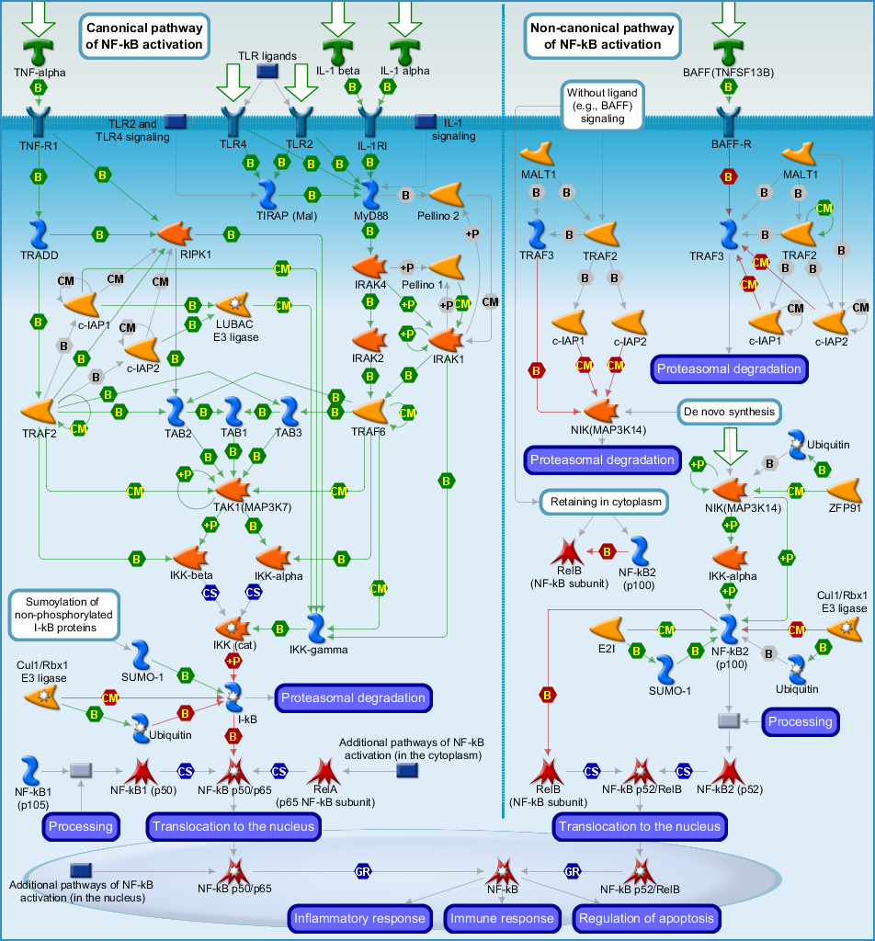
Biology view from different people
+
view from math / computer science
view from biologist / chemist

Slide 5
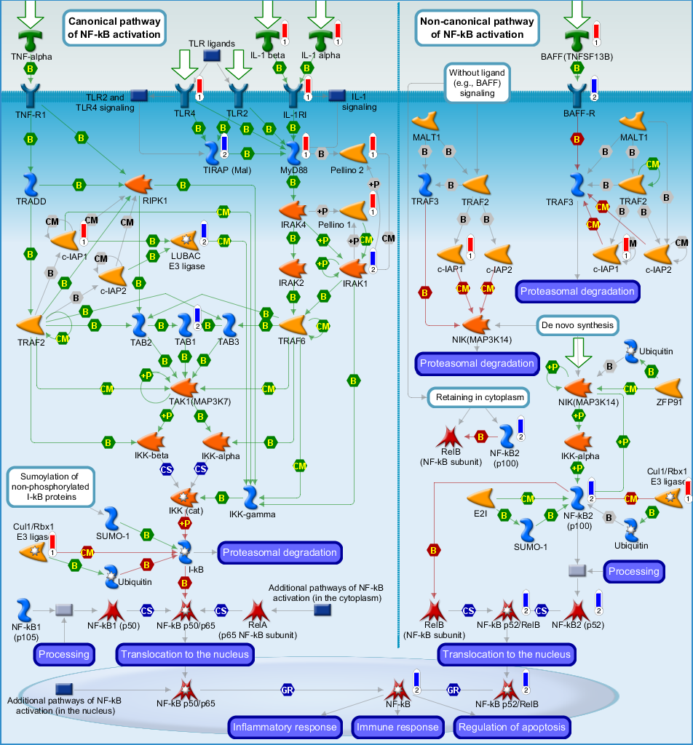
Biological knowledge is the key for pharmaceutical industry
knowledge

Slide 6
Knowledge Bases
Biological information is out there in hundreds of biological databases
Information is not knowledge
Curation and knowledge management strategy are important
Knowledge bases are the essential asset to have to help with pharma/biotech companies
Internal drug discovery and development
Competitive intelligence

Slide 7
Literature Based Knowledge Bases
Curated from publications
Noisy, information from all possible contexts (experiment condition, sample used differently etc.)
Manual curation
High confidence
Low throughput
Text mining
Medium/low confidence
High throughput

Slide 8
Data driven Knowledge Base
GEO / Array Express contain molecular profiling data
Company proprietary data (animal model or clinical trial)
Context specific knowledge is more relevant to drug discovery

Slide 9
Represent Knowledge as Graphs (Networks) and Build Analytical Pipelines
Literature
Existing public sources
OMICs
(semi-) automatic extraction
collect public networks/pathways
data driven network
Standardization & Sharing
Internal
tools
Public
tools
Algorithm repository
Network Repository
Benchmarking &
Pipelines
Visualization

Slide 10
Knowledge Base Related Challenges
Different ontologies used
KB Integration is not straight forward for literature and data driven knowledge bases
Sharing same public domain knowledge (without each company re-creating the wheel) is challenging

Slide 11
ADNI and AIBL Data
ADNI and AIBL are two studies for understanding Alzheimer’s Disease progression
They both collect comprehensive information for hundreds of individuals over several years
Omics: whole genome sequencing, transcriptome, etc.
Clinical data: cognitive tests, labs, etc.
Imaging data: PET and MRI brain scans and derived metrics
Biomarker data: e.g. protein expression in blood
Demographics
Data are available through a common archive (LONI)

Slide 12
ADNI and AIBL Data Integration Problem
Problem Statement:
Academic and Industry projects aim to find models/results that can be validated in multiple, independent datasets, which requires global schema construction and data harmonization
(Data) Goal:
Have a unified data model that can accommodate multiple studies for cross-study querying and analysis
The challenges in achieving data goal are:
Multiple centers collect data without upfront data organization strategy resulting in several disjoint datasets that are subsequently consolidated – in the case of ADNI there are > 200 text files with common person ID and visit number
Inherent to all biomedical data, fields are messy (free text, data entry errors, unit mismatches)
Different studies have different protocols, (slightly) different aims, in different regions, in different people, and therefore collect different data

Slide 13
ADNI-Specific Challenges
ADNI actually contains 3 sub-studies
ADNI 1, then ADNI GO, then ADNI 2
Same person may be enrolled in one or more sub-studies, concurrently or disjointed
Variable names and values may not be harmonized across sub-studies
Data redundancy
To facilitate data analysis, ADNI statisticians provide a merged dataset called ADNIMERGE that contains commonly used variables – therefore, this is a direct copy of subset of variables from the text files
When both common and non-ADNIMERGE variables are needed, users may unnecessarily join ADNIMERGE with data in other text files creating redundancies
A smart query system that automatically selects the minimal number of text files traversed to return requested data would minimizes redundancies and logic-conflicts (from processed ADNIMERGE versus unprocessed text files)
Data describing the same field (e.g. medication) may be partially controlled with details in free text
Medication history is found in multiple files recorded either as a specific, and controlled, background question or as free text

Slide 14
Registry dataset challenges
Identify the global schema to accommodate different studies
Identify data redundancy to improve data completeness

Slide 15
THANK YOU!

