Slide 1

Trends in
Scalable Stream Processing:
Parallelism & Programmability
Peter Pietzuch
Large-Scale Distributed Systems Group
Department of Computing, Imperial College London
http://lsds.doc.ic.ac.uk
prp@doc.ic.ac.uk
ATI Oxford Meeting 2016 - London

Slide 2
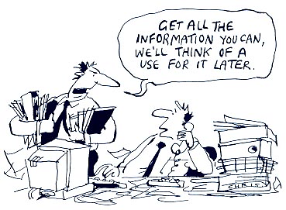
How to Make Sense of Big Data On-The-Fly?
More data than ever is…
  created: 2.5 Exabytes (billion GBs) generate each day in 2015
  stored: hard drive cost per GB dropped from $8.93 (2000) to $0.03 (2014)
Many new sources of data become available
  sensors, mobile devices, cameras
  web feeds, social networking
  databases
  scientific instruments
 But data value decreases over time…

Slide 3
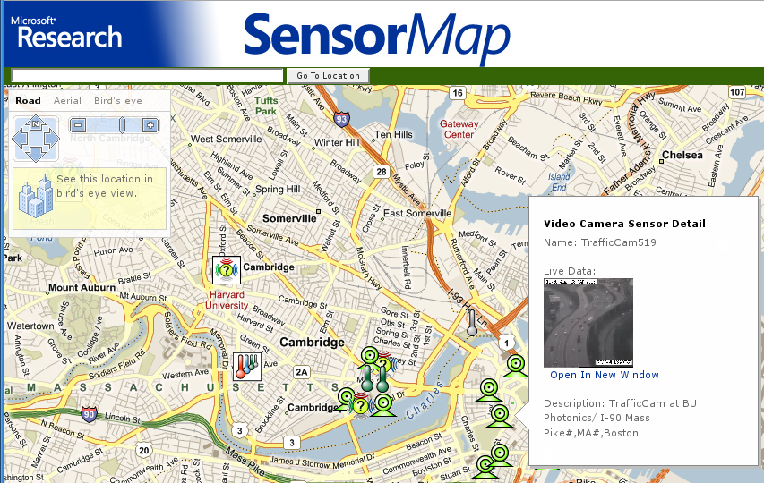
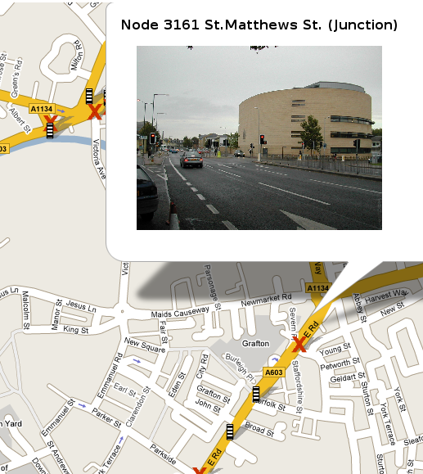
Real-Time Analysis of Sensed Data
Supporting intelligent transportation services
  Many interested parties
    Road authorities, traffic planners, emergency services, commuters
  Analytics queries
    Intelligent route planning:
    “What is the best time/route for my commute through central London between 7am-8am?”
    Emergency response
    Informing urban planning

Slide 4

Machine Learning for Web Analytics
Problem: Provide up-to-date predictions regarding which ads to serve
Solution: AdPredictor
Bayesian online learning algorithm ranks adverts according to click probabilities
…
Pre-process
Share state
…
Parallelize
…
f_{n}
Aggregate
Iterate
update
…
f₁
y E {−1,1}
predict

Slide 5
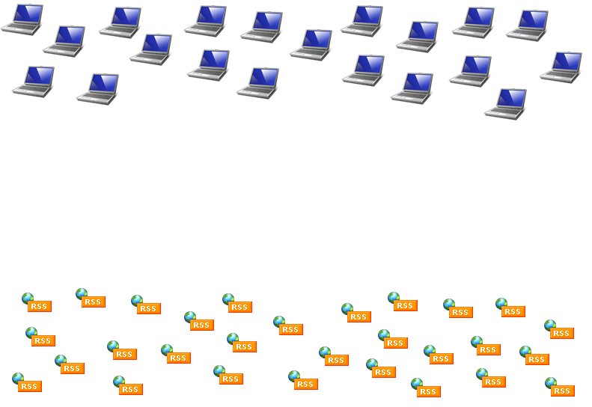
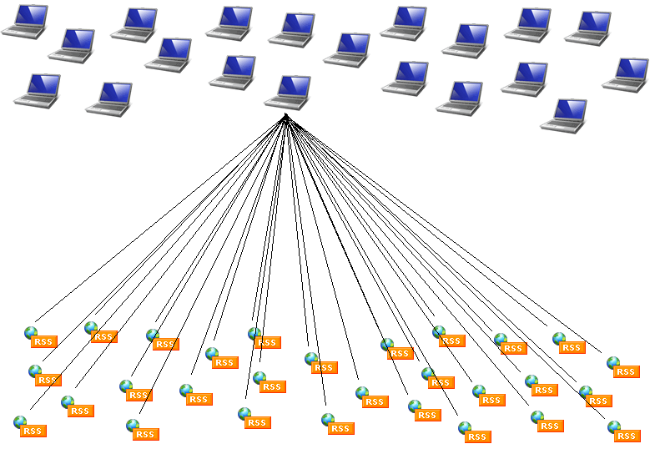
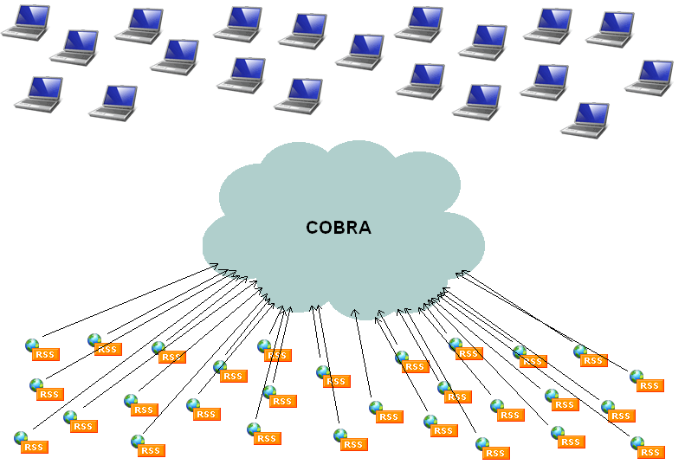
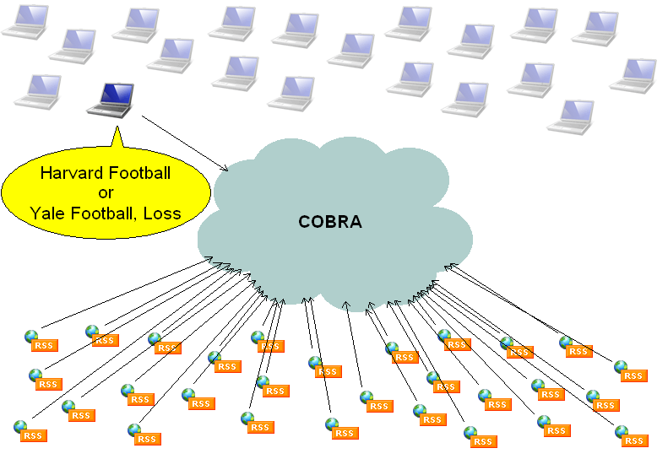

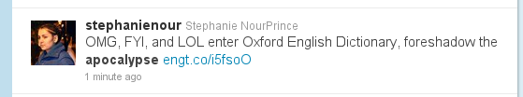
Real-Time Social Data Mining
Social Cascade Detection

Slide 6



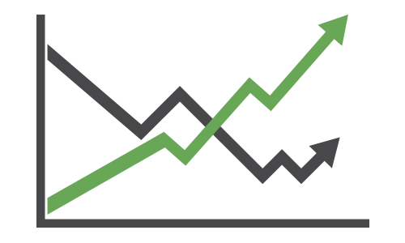





Throughput and Latency Matter
…
High-throughput streams
Low-latency results
Facebook Insights: Aggregates 9 GB/s < 10 sec latency
Google Zeitgeist: 40K user queries/s (1-sec windows) < 1 ms latency
Feedzai: 40K credit card transactions/s < 25 ms latency
NovaSparks: 150M trade options/s < 1 ms latency

Slide 7
Design Space for Big Data Systems
Volume and Velocity
Algorithmic complexity
  Arbitrary data transformation
  Iterative algorithms
  Large state as part of computation
EBs
PBs
Hard for
all algo-
rithms
Data amount
TBs
Hard for
complex
algorithms
GBs
Easy
days
hours
mins
secs
millisecs
Latency

Slide 8
Database Centric Processing Doesn’t Work
Traditional Database Management System (DBMS)
  Data relatively static but queries dynamic
DBMS
Queries
Results
  Potentially high query latency
  Updates limited by disk I/O
  Indices of limited use for fast changing data
Index
Data

Slide 9
Stream Processing to the Rescue!
Data Stream Processing System (DSPS)
  Data represented as time-dependant data stream
  Queries static but data dynamic
DSPS
Stream
Results
  Low latency result stream
  In-memory architecture
  Transient state
Working
Storage
Queries

Slide 10
Relational Data Stream Model
Streams consist of infinite sequence of tuples
  Tuples typically associated with timestamp, e.g. arrival time, time of reading, ...
Tuples can have fixed relational schema
  Set of attributes
highway = M25 segment = 42 direction = north speed = 85
Vehicles(highway, segment, direction, speed)
Vehicle speed data
t₁
t₂
t₃
t₄
...
highway segment direction speed | highway segment direction speed | highway segment direction speed | highway segment direction speed | highway segment direction speed | highway segment direction speed | highway segment direction speed | highway segment direction speed | highway segment direction speed | highway segment direction speed
Sensors data stream
time

Slide 11
Windows for Processing Infinite Streams
How many tuples should we process each time?
Process tuples in window-sized batches
  Time-based window with size τ at current time t
  [t - τ : t] Vehicles[Range τ seconds]
  [t : t] Vehicles[Now]
  Count-based window with size n:
  last n tuples Vehicles[Rows n]
window
highway segment direction speed | highway segment direction speed | highway segment direction speed | highway segment direction speed | highway segment direction speed | highway segment direction speed | highway segment direction speed | highway segment direction speed | highway segment direction speed | highway segment direction speed
now

Slide 12
Providing Well-Defined Query Semantics
CQL: SQL-based declarative language for continuous queries
  Based on well-defined relational algebra (select, project, join, …)
Example: Identifying slow moving traffic on a highway:
  Find highway segments with average speed below 40 km/h
select highway, segment, direction, AVG(speed) as avg
from Vehicles[range 5 seconds slide 1 second]
group by highway, segment, direction
having avg < 40

Slide 13
Roadmap
Introduction to Stream Processing
(1) Scalable and Parallel Stream Processing…
…but with Principled Query Semantics
(2) Streaming Machine Learning Applications…
...but with a Natural Programming Model
Conclusions

Slide 14
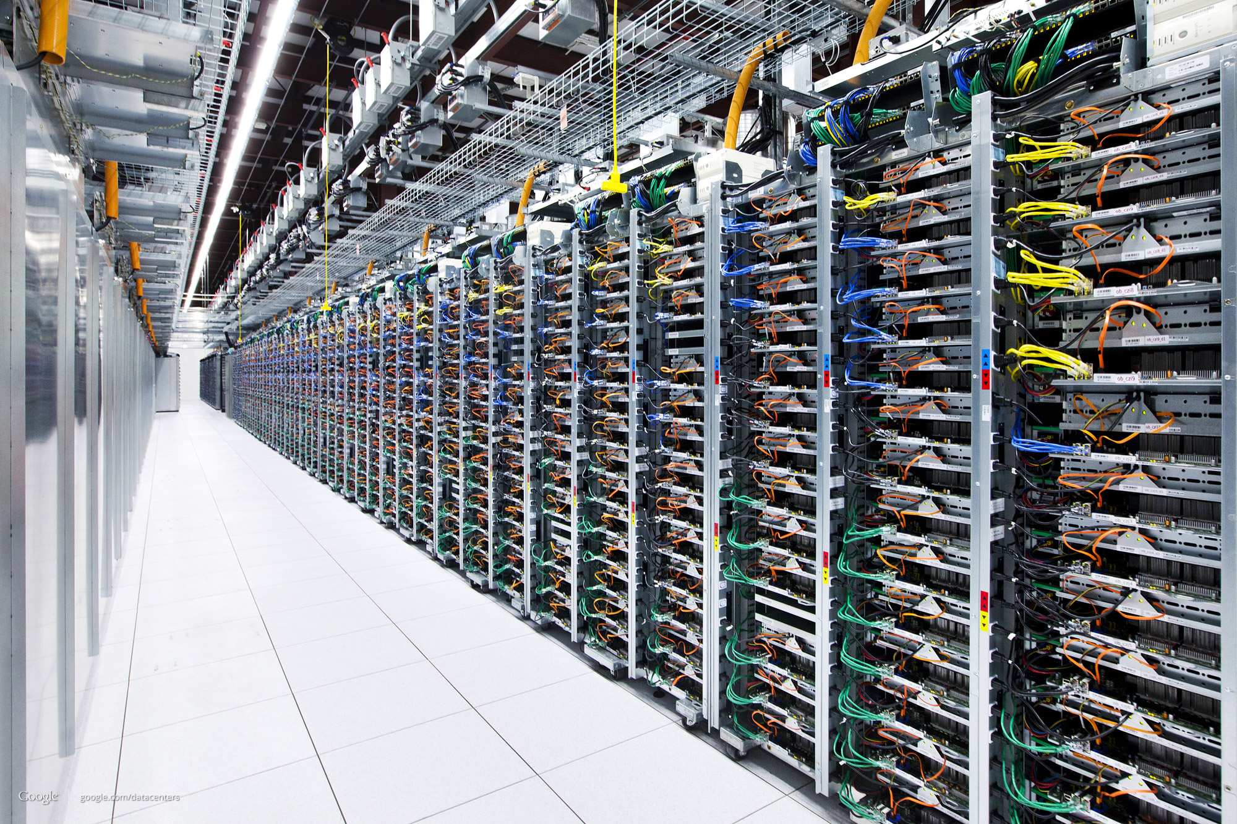
How to Scale Big Data Systems?
Use scale out and not scale up
  Commodity multi-core servers
  Fast network interconnect
Data-parallelism is king
Software designed for failure
Google: over 20 data centre locations
  over 1 million servers
  260 Megawatts (0.01% of global energy)
  4.2 billion searches per day (2011)
  Exabytes (10¹⁸) of storage
Notes:
5 MB of data

Slide 15
Need to Exploit Parallel Hardware
Servers have many parallel CPU cores
Servers with GPUs common
  GPU have even more specialised cores
PCIe Bus
Command Queue
SMX₁ ... SMX_{N}
Socket 1
C₁
C₅
Socket 2
C₁
C₅
10s of SMXs
1000s of FP32 cores
100s of FP64 cores
C₂
C₆
C₂
C₆
C₃
C₇
C₃
C₇
C₄
C₈
C₄
C₈
L3
L3
L2 Cache
10s of KB L2 Cache
10s of GB DRAM
DRAM
DMA
DRAM

Slide 16
Task vs Data Parallelism
Streams
...
Results
n machines in
data centre
select distinct W.cid
From Payments [range 300 seconds] as W,
Payments [partition-by 1 row] as L
where W.cid = L.cid and W.region != L.region
select distinct W.cid
From Payments [range 300 seconds] as W,
Payments [partition-by 1 row] as L
where W.cid = L.cid and W.region != L.region
select highway, segment, direction, AVG(speed)
from Vehicles[range 5 seconds slide 1 second]
group by highway, segment, direction
having avg < 40
select distinct W.cid
From Payments [range 300 seconds] as W,
Payments [partition-by 1 row] as L
where W.cid = L.cid and W.region != L.region
select highway, segment, direction, AVG(speed)
from Vehicles[range 5 seconds slide 1 second]
group by highway, segment, direction
having avg < 40
Task parallelism:
Multiple queries
Data parallelism:
Single query

Slide 17
Use Apache Hadoop for Stream Processing?
Data model: (key, value) pairs
MapReduce model
Two processing functions:
  map(k₁,v₁) → list(k₂,v₂)
  reduce(k₂, list(v₂)) → list (v₃)
Benefits:
  Simple programming model
  Transparent parallelisation
  Fault-tolerant processing
reduce
R
R
R
shuffle
map
M
M
M
partitioned data on HDFS distributed file system

Slide 18

Executing Hadoop Jobs on Cluster
Map/reduce tasks scheduled across cluster nodes
Shuffle phase (repartitioning) introduces synchronisation barrier
R
M
M
M
R
R
 MapReduce is a batch processing model…

Slide 19
Apache Spark: Micro-Batching
UC Berkeley,
SOSP’13
Idea:
Reduce size of data partitons to produce up-to-date, incremental results
Micro-batching for data
  Compute tasks operate on micro-batch partition
  Parallel recomputation of partition after failure
Challenges:
Scheduling overhead for small partitions?
Query semantics with micro-batches?
Input data is discretised stream

Slide 20
Apache Storm: Pipelined Dataflows
Idea:
Materialise tasks in dataflow graph to avoid scheduling overhead
Many systems do this, e.g. Apache Storm, Apache Flink, SEEP, Google Dataflow, …
Challenges:
Allocation of tasks to nodes?
Failure recovery?

Slide 21
Latency Impact of Micro-Batches
Streaming word count of text data
  Deployed on 4 nodes (4-core 3.4 Ghz Intel Xeon with 8 GB RAM)
SEEP

Slide 22
Parallel Processing with Sliding Windows
select highway, segment, direction, AVG(speed) as avg
from cars [range 5 seconds slide 1 second]
group by highway, segment, direction
having avg < 40
7
6
5
4
3
2
1
w₁
Task
Worker A
w₂
Synchronise to output results in order
w₃
Task
Worker B
w₄
 Leads to redundant computation

Slide 23
No Redundant Computation with Panes
Pane: smallest unit of parallelism without data dependencies based on window semantics
  Pane size = gcd (window size, slide)
7
6
5
4
3
2
1
p₁
p₂
p₃
Panes can be processed in parallel
Window results assembled by panes results
p₄
p₅
p₆
p₇
p₈

Slide 24
How to Relate Panes to Tasks?
Spark imposes lower bound on window slide
1s
2s
3s
4s
5s
  Window slide limited by min. latency (~500 ms)
Micro-batch size limited by window slide
 Avoid coupling query performance with query definition

Slide 25
SABER: Window Fragment Model
Imperial,
SIGMOD’16
Idea: Decouple task size from window size/slide
  e.g. 5 tuples/task, window size 7 rows, slide 2 rows
T₃
T₂
T₁
15
14
13
12
11
10
9
8
7
6
5
4
3
2
1
w₁
w₁
w₂
w₂
w₃
w₃
w₄
w₄
w₅
w₅
Task contains one or more window fragments
  Closing/pending/opening windows in T₂
  Workers can process fragments incrementally

Slide 26
Merge Window Fragment Results
Idea: Decouple task size from window size/slide
  Assemble window fragment results
  Output them in correct order
Worker A: T₁
w₁
w₂
_{result}
w₂
w₃
Empty
Empty
w₁
_{result}
w₁
w₂
w₃
Slot 2
Slot 1
w₄
Output result
circular buffer
w₅
Result Stage
Worker B: T₂
  Worker B stores T₂ results and exits (nothing to forward)
  Worker A stores T₁ results, merges window fragment results and forwards complete windows downstream

Slide 27
SABER: Window Performance
select AVG(S.1) from S [rows 1024 slide x]

Slide 28
Roadmap
Introduction to Stream Processing
(1) Scalable and Parallel Stream Processing…
…but with Principled Query Semantics
(2) Streaming Machine Learning Applications…
...but with a Natural Programming Model
Conclusions

Slide 29
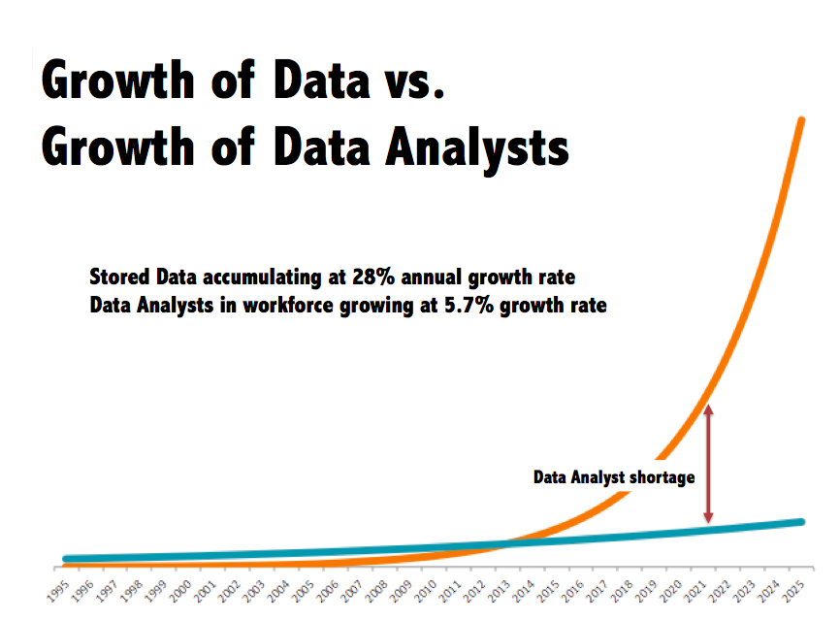
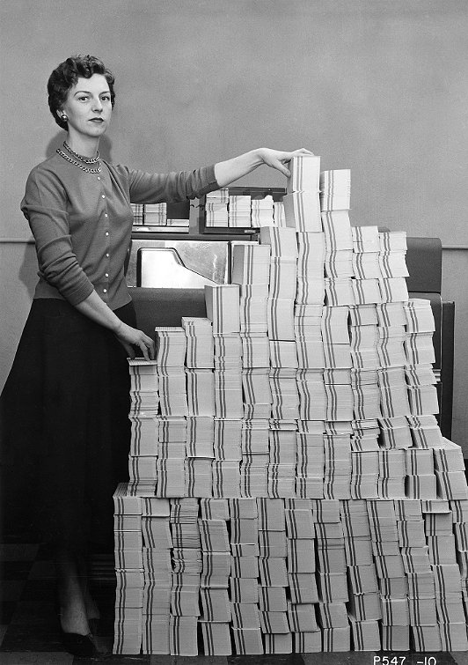
Democratising Big Data Analytics
 Need to enable more users to do (streaming) analytics…
Notes:
5 MB of data

Slide 30
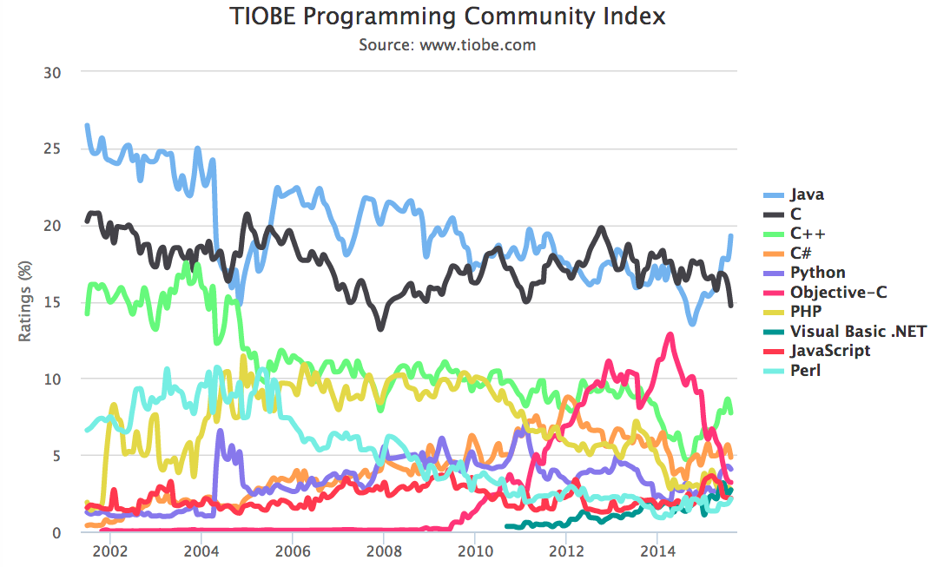
Programming Language Popularity

Slide 31
Programming Models For Streaming Apps?
Declarative query languages (e.g. CQL) challenging for complex algorithms
  Consider iterative machine learning algorithms over streaming data
  Typically need to use user-defined functions (UDFs)
Domain experts tend to write imperative programs
  Java, Matlab, C++, R, Python, Fortran, …
Distributed dataflow frameworks favour functional programming models
  MapReduce, SQL, PIG, DryadLINQ, Spark, …
  Simplifies consistency and fault tolerance

Slide 32
ML Example: Recommender System
Recommendations based on past user behaviour through collaborative filtering (cf. Netflix, Amazon, …)
Rating: 3
User A
Recommend: “Apple Watch”
User A
Item: “iPhone”
Rating: 5
Customer activity
on website
Up-to-date
recommendations
Distributed dataflow graph
(eg Hadoop, Spark, Dryad, Flink, Naiad, …)

Slide 33
Online Collaborative Filtering in Java
Update with new ratings
Matrix userItem = new Matrix();
Matrix coOcc = new Matrix();
 | Item-A | Item-B
User-A | 4 | 5
User-B | 0 | 5
void addRating(int user, int item, int rating) {
userItem.setElement(user, item, rating);
updateCoOccurrence(coOcc, userItem);
}
User-Item matrix (UI)
Vector getRec(int user) {
Vector userRow = userItem.getRow(user);
Vector userRec = coOcc.multiply(userRow);
return userRec;
}
Multiply for recommendation
 | Item-A | Item-B
Item-A | 1 | 1
Item-B | 1 | 2
User-B | 1 | 2
x
Co-Occurrence matrix (CO)

Slide 34
Collaborative Filtering in Spark (Java)
// Build the recommendation model using ALS
int rank = 10;
int numIterations = 20;
MatrixFactorizationModel model = ALS.train(JavaRDD.toRDD(ratings), rank, numIterations, 0.01);
// Evaluate the model on rating data
JavaRDD<Tuple2<Object, Object>> userProducts = ratings.map(
new Function<Rating, Tuple2<Object, Object>>() {
public Tuple2<Object, Object> call(Rating r) {
return new Tuple2<Object, Object>(r.user(), r.product());
}
}
);
JavaPairRDD<Tuple2<Integer, Integer>, Double> predictions = JavaPairRDD.fromJavaRDD(
model.predict(JavaRDD.toRDD(userProducts)).toJavaRDD().map(
new Function<Rating, Tuple2<Tuple2<Integer, Integer>, Double>>() {
public Tuple2<Tuple2<Integer, Integer>, Double> call(Rating r){
return new Tuple2<Tuple2<Integer, Integer>, Double>(
new Tuple2<Integer, Integer>(r.user(), r.product()), r.rating());
}
}
));
JavaRDD<Tuple2<Double, Double>> ratesAndPreds = JavaPairRDD.fromJavaRDD(ratings.map(
new Function<Rating, Tuple2<Tuple2<Integer, Integer>, Double>>() {
public Tuple2<Tuple2<Integer, Integer>, Double> call(Rating r){
return new Tuple2<Tuple2<Integer, Integer>, Double>(
new Tuple2<Integer, Integer>(r.user(), r.product()), r.rating());
}
}
)).join(predictions).values();

Slide 35
Collaborative Filtering in Spark (Scala)
// Build the recommendation model using ALS
val rank = 10
val numIterations = 20
val model = ALS.train(ratings, rank, numIterations, 0.01)
// Evaluate the model on rating data
val usersProducts = ratings.map {
case Rating(user, product, rate) => (user, product)
}
val predictions =
model.predict(usersProducts).map {
case Rating(user, product, rate) => ((user, product), rate)
}
val ratesAndPreds = ratings.map {
case Rating(user, product, rate) => ((user, product), rate)
}.join(predictions)
 All data is immutable, no fine-grained model updates

Slide 36
Streaming State as First Class Citizen
Tasks process stream data
Item 1
Item 2
Dataflows represent
streams
User A
2
5
User B
4
1
State Elements (SEs) represent transient state
State elements (SEs) are mutable in-memory data structures
  Tasks have local access to SEs
  SEs can be shared between tasks

Slide 37
Challenges with Large Streaming State
State will not fit into single node
Challenge: Handling of distributed state?
Big Data problem:
Matrices
become large
Matrix userItem = new Matrix();
Matrix coOcc = new Matrix();

Slide 38
Partitioned State Elements
Idea: Partitioned SE split into disjoint partitions
[0-k]
Key space: [0-N]
[(k+1)-N]
User-Item matrix (UI)
 | Item-A | Item-B
User-A | 4 | 5
User-B | 0 | 5
Access
by key
hash(msg.id)
Dataflow routed according to
hash function
State partitioned according
to partitioning key

Slide 39
Partial State Elements
Partial SEs are replicated (when partitioning is impossible)
  Tasks have local access
Access to partial SEs either local or global
Local access:
Data items sent to one
Global access:
Data items sent to all

Slide 40

Stateful Dataflow Graphs (SDG)
Imperial,
USENIX
ATC’14
Annotated Java program
(@Partitioned, @Partial, @Global, …)
SEEP distributed dataflow
framework
Data-parallel
Stateful Dataflow Graph (SDG)
Cluster
Program.java
Static
program
analysis
Translation &
checkpoint-based fault tolerance

Slide 41
SDG: Online Logistic Regression
  100 GB training dataset for classification
  Deployed on Amazon EC2 (“m1.xlarge” VMs with 4 vCPUs and 16 GB RAM)
SDG
Spark
 SDGs have comparable throughput to Spark despite mutable state

Slide 42

Summary
Scalable stream processing key component in today’s Big Data stacks
  Many applications and services require real-time view of data streams
  Online machine learning is growing in importance
(1) Modern parallel hardware (multicore CPUs/GPUs) raises challenges
  Need new system designs that exploit data parallelism
  Must not compromise well-founded query semantics
 SABER: Windows handling in parallel streaming engine
(2) Easy-of-use key in adoption of streaming platforms
  Complex streaming applications require expressive programming models
  Want to provide programming abstractions that are natural to users
 SDG: Stateful stream processing for machine learning
Peter Pietzuch
<prp@doc.ic.ac.uk>
http://lsds.doc.ic.ac.uk
Thank you! Any Questions?

