Slide 1
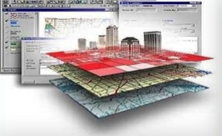
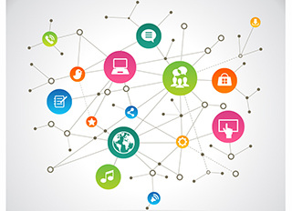
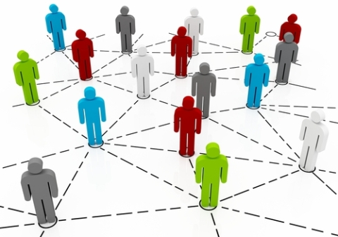
How Can RDF and OWL Coexist with Property Graph
Zhe Wu
Architect
Oracle Spatial and Graph
May, 2016

Slide 3
Direction of Development in Graph & Semantics Area
RDF, OWL, SPARQL
Property Graph
Other Data Types
3
Notes:
The property graph is what we have introduced on the Big Data platform. Again, it’s the most basic graph structure and is a very simple and flexible type of graph. It can pull together a lot of disparate information for analysis.
This is a more formal view of what the property graph data model looks like. In the property graph world, nodes are called vertices and links are called edges.
You have a set of vertices with properties (or attributes ) in the form of key value pairs and you have a set of edges connecting these vertices.
We support theTinkerpop technology stack – Blueprint graph manipulation APIs, Pipes data flow APIs, Gremlin graph traversal language– to which Oracle has added built-in analytics functions

Slide 4
Direction of Development in Graph & Semantics Area “Facets”
RDF, OWL, SPARQL
Searchability
Security
Tools
Fashion!
User Interface
Property Graph
Programming interfaces
Solution
JSON, Spatial,
Big Data, Relational
Scalability
Multiple Platforms
4
Notes:
The property graph is what we have introduced on the Big Data platform. Again, it’s the most basic graph structure and is a very simple and flexible type of graph. It can pull together a lot of disparate information for analysis.
This is a more formal view of what the property graph data model looks like. In the property graph world, nodes are called vertices and links are called edges.
You have a set of vertices with properties (or attributes ) in the form of key value pairs and you have a set of edges connecting these vertices.
We support theTinkerpop technology stack – Blueprint graph manipulation APIs, Pipes data flow APIs, Gremlin graph traversal language– to which Oracle has added built-in analytics functions

Slide 5
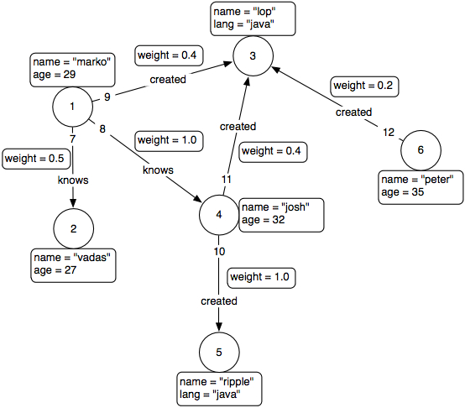
Property Graph Data Model
A set of vertices (or nodes)
each vertex has a unique identifier.
each vertex has a set of in/out edges.
each vertex has a collection of key-value properties.
A set of edges
each edge has a unique identifier.
each edge has a head/tail vertex.
each edge has a label denoting type of relationship between two vertices.
each edge has a collection of key-value properties.
Blueprints Java APIs
Implementations
Oracle, Neo4j, DataStax(Titan), InfiniteGraph, Dex, Sail, MongoDB …
https://github.com/tinkerpop/blueprints/wiki/Property-Graph-Model
5
Notes:
The property graph is what we have introduced on the Big Data platform. Again, it’s the most basic graph structure and is a very simple and flexible type of graph. It can pull together a lot of disparate information for analysis.
This is a more formal view of what the property graph data model looks like. In the property graph world, nodes are called vertices and links are called edges.
You have a set of vertices with properties (or attributes ) in the form of key value pairs and you have a set of edges connecting these vertices.
We support theTinkerpop technology stack – Blueprint graph manipulation APIs, Pipes data flow APIs, Gremlin graph traversal language– to which Oracle has added built-in analytics functions

Slide 6
Architecture of Property Graph Support
Graph Analytics
REST/Web Service
Java, Groovy, Python, …
Parallel In-Memory Graph Analytics (PGX)
Property Graph formats
Java APIs
Graph Data Access Layer (DAL)
Blueprints & Lucene/SolrCloud
GraphML
GML
Graph-SON
Flat Files
RDF (RDF/XML, N-Triples, N-Quads, TriG,N3,JSON)
Java APIs/JDBC/SQL/PLSQL
Scalable and Persistent Storage Management
Oracle RDBMS
Apache HBase
Oracle NoSQL Database

Slide 7
Oracle’s In-Memory Analyst vs Spark GraphX 1.1
In-Memory Analyst on 1 node is up to 2 orders of magnitude faster than Spark GraphX distributed execution on 2 to 16 nodes
Pagerank
Single-Source Shortest Path
Notes:
The benchmark involved four popular graph algorithms that are frequently used for performance testing. The results (in log-scale) show that Oracle Big Data Spatial and Graph significantly outperform Spark GraphX, often by more than two orders of magnitude
The Spark 1.4.1 documentation documents GraphX built-in support for three algorithms - PageRank, Connected Components, and Triangle Counting. Oracle implemented Single-Source Shortest Path, Hop-distance, and Eigenvector Centrality on GraphX according to the documentation for this benchmark.
Two large public graph instances were used for the benchmarking. Random weights were generated on every edge with uniform distribution for running Single-source Shortest Path algorithm. This was done because the original graph instances did not have edge weights.
Total execution time is reported for Single-source Shortest Path and Hop-Dist. Per-iteration execution time is reported for Pagerank and Eigenvector Centrality. The per-iteration execution time is reported because these algorithms repeat the same computation until the arbitrary convergence condition is met; execution time per iteration is more relevant to evaluate the performance
CPU: Intel “Sandy Bridge”, Xeon E5-2660, 2.20 GHz, 8 Cores (x 2 HT)
Memory: 256 GB (DDR3 – 1600)
SSD: 3 x 256 GB (combination of OCZ Vertex 4 and Samsung 840 Pro)
Network Card: Mellanox Connect-IB (InfiniBand Adapter)
Switch: Mellanox SX6512 (InfiniBand Switch)
Data sets: Verticies / Edges
Twitter followership 2010: 41,652,230 1,468,365,182
Web page relations .UK domain: 77,741,046 2,965,197,340

Slide 8
Oracle’s In-Memory Analyst vs Spark GraphX 1.1
In-Memory Analyst on 1 node is up to 2 orders of magnitude faster than Spark GraphX distributed execution on 2 to 16 nodes
Hop-Dist
Eigenvector Centrality
Notes:
The benchmark involved four popular graph algorithms that are frequently used for performance testing. The results (in log-scale) show that Oracle Big Data Spatial and Graph significantly outperform Spark GraphX, often by more than two orders of magnitude
The Spark 1.4.1 documentation documents GraphX built-in support for three algorithms - PageRank, Connected Components, and Triangle Counting. Oracle implemented Single-Source Shortest Path, Hop-distance, and Eigenvector Centrality on GraphX according to the documentation for this benchmark.
Two large public graph instances were used for the benchmarking. Random weights were generated on every edge with uniform distribution for running Single-source Shortest Path algorithm. This was done because the original graph instances did not have edge weights.
Total execution time is reported for Single-source Shortest Path and Hop-Dist. Per-iteration execution time is reported for Pagerank and Eigenvector Centrality. The per-iteration execution time is reported because these algorithms repeat the same computation until the arbitrary convergence condition is met; execution time per iteration is more relevant to evaluate the performance
CPU: Intel “Sandy Bridge”, Xeon E5-2660, 2.20 GHz, 8 Cores (x 2 HT)
Memory: 256 GB (DDR3 – 1600)
SSD: 3 x 256 GB (combination of OCZ Vertex 4 and Samsung 840 Pro)
Network Card: Mellanox Connect-IB (InfiniBand Adapter)
Switch: Mellanox SX6512 (InfiniBand Switch)
Data sets: Verticies / Edges
Twitter followership 2010: 41,652,230 1,468,365,182
Web page relations .UK domain: 77,741,046 2,965,197,340

Slide 9
Oracle’s In-Memory Analyst vs. Dato GraphLab Create
In-Memory Analyst on a single machine is 3x – 10x faster than a GraphLab 16-machine distributed execution
Oracle(SPARC)
Oracle(X86)
GraphLab (X86 x 16)
Notes:
This yields some very good performance. When using a single server node, PGX is much faster than existing state of the art distributed graph processing engines as well as more traditional relational solutions. [] Here we show the runtime in seconds of two popular graph algorithms. Note that we use a logarithmic scale and lower is better. [] We compare the performance of a single node instance of PGX running on x86 and SPARC and compare its performance against GraphLab, a state of art open source distributed graph engine as well as a SQL implementation of the same algorithms running on the same machine. [] We see that PGX is 3 to 10x faster when running on one machine than Graphlab is, when running on 16 similar machines.

Slide 10
Linear Scalability Loading in NoSQL w/ Parallelism
NoSQL 8-Node BDA: Oracle NoSQL Database Enterprise Edition 3.2.5, 8 Storage Nodes, 12 Replication Nodes/Storage Node, 8.5G Heap Size/Replication Node, Replication Factor 1
Client: Heap Size 48G, 2 Clients

Slide 11
4-6 Seconds for Analytics on 4.8m Vertices w/ 68.9m Edges (2.9 GB) w/ Parallel In-Memory Analyst
Oracle Big Data Spatial and Graph: Property Graph - In-Memory Analyst Apache HBase 1.0: Parallel Graph Analytics on LiveJ Data
Notes:
Client settings: -Xmx48g –Xms48g
1 client
DB Settings:
<property><name>hbase.hstore.flusher.count</name><value>1</value></property>
<property><name>hbase.regionserver.handler.count</name><value>72</value></property>
<property><name>hbase.hregion.max.filesize</name><value>1610612736</value></property>
<property><name>hbase.hregion.memstore.block.multiplier</name><value>4</value></property>
<property><name>hbase.hregion.memstore.flush.size</name><value>134217728</value></property>
<property><name>hbase.hstore.blockingStoreFiles</name><value>200</value></property>
java -Doracle.pg.showProgress=true -XX:+PrintGCDetails -XX:+PrintGCTimeStamps -verbose:gc -XX:+UseParNewGC -XX:+UseConcMarkSweepGC -XX:CMSInitiatingOccupancyFraction=70 -XX:+UseCMSInitiatingOccupancyOnly -Xms48G -Xmx48G -classpath ../../lib/:../../lib/'*':.:./classes TestHBasePGX $QUORUM $PORT $GRAPH $DOP $OPTFLAG > /tmp/log_${DATE}_pgx_client_bda4105_${GRAPH}_heap_${HEAP}_dop_${DOP}_optFlag_${OPTFLAG}

Slide 12
Strengths and Weaknesses
Semantic web/RDF graph
Formal theoretical foundation, precise, lots of standards/curated terms/vocabularies, linked data
Property graph
Easy to learn (actually not much to learn)
Suitable for social network analysis
Semantic web/RDF graph
Steep learning curve
Hidden complexity
Property graph
Lack of standard/query language
How to deal with multiple property graphs?
How can an application make use of both?
12
Notes:
The property graph is what we have introduced on the Big Data platform. Again, it’s the most basic graph structure and is a very simple and flexible type of graph. It can pull together a lot of disparate information for analysis.
This is a more formal view of what the property graph data model looks like. In the property graph world, nodes are called vertices and links are called edges.
You have a set of vertices with properties (or attributes ) in the form of key value pairs and you have a set of edges connecting these vertices.
We support theTinkerpop technology stack – Blueprint graph manipulation APIs, Pipes data flow APIs, Gremlin graph traversal language– to which Oracle has added built-in analytics functions

Slide 13
Semantic Web/RDF Graph Coexists with Property Graph
Step 1: Stick them into the same repository
13
Notes:
The property graph is what we have introduced on the Big Data platform. Again, it’s the most basic graph structure and is a very simple and flexible type of graph. It can pull together a lot of disparate information for analysis.
This is a more formal view of what the property graph data model looks like. In the property graph world, nodes are called vertices and links are called edges.
You have a set of vertices with properties (or attributes ) in the form of key value pairs and you have a set of edges connecting these vertices.
We support theTinkerpop technology stack – Blueprint graph manipulation APIs, Pipes data flow APIs, Gremlin graph traversal language– to which Oracle has added built-in analytics functions

Slide 14
Semantic Web/RDF Graph Coexists with Property Graph
Step 2: Force them to speak the same language (Java, SQL, REST, …)
14
Notes:
The property graph is what we have introduced on the Big Data platform. Again, it’s the most basic graph structure and is a very simple and flexible type of graph. It can pull together a lot of disparate information for analysis.
This is a more formal view of what the property graph data model looks like. In the property graph world, nodes are called vertices and links are called edges.
You have a set of vertices with properties (or attributes ) in the form of key value pairs and you have a set of edges connecting these vertices.
We support theTinkerpop technology stack – Blueprint graph manipulation APIs, Pipes data flow APIs, Gremlin graph traversal language– to which Oracle has added built-in analytics functions

Slide 15
Semantic Web/RDF Graph Coexists with Property Graph
Step 3: Disguise one as the other
Property graph view on RDF & RDF view on property Graph
15
Notes:
The property graph is what we have introduced on the Big Data platform. Again, it’s the most basic graph structure and is a very simple and flexible type of graph. It can pull together a lot of disparate information for analysis.
This is a more formal view of what the property graph data model looks like. In the property graph world, nodes are called vertices and links are called edges.
You have a set of vertices with properties (or attributes ) in the form of key value pairs and you have a set of edges connecting these vertices.
We support theTinkerpop technology stack – Blueprint graph manipulation APIs, Pipes data flow APIs, Gremlin graph traversal language– to which Oracle has added built-in analytics functions

Slide 16
Property Graph View on RDF Data
Specify
Which set of assertions become “attributes”
Which set of assertions become edges
ns:vertex1 ns:name “marko” .
ns:vertex1 ns:age 29 .
ns:vertex1 ns:created ns:vertex3 .
16
Notes:
The property graph is what we have introduced on the Big Data platform. Again, it’s the most basic graph structure and is a very simple and flexible type of graph. It can pull together a lot of disparate information for analysis.
This is a more formal view of what the property graph data model looks like. In the property graph world, nodes are called vertices and links are called edges.
You have a set of vertices with properties (or attributes ) in the form of key value pairs and you have a set of edges connecting these vertices.
We support theTinkerpop technology stack – Blueprint graph manipulation APIs, Pipes data flow APIs, Gremlin graph traversal language– to which Oracle has added built-in analytics functions

Slide 17
Property Graph View on RDF Data
Specify
Which set of assertions become “attributes”
Which set of assertions become edges
ns:vertex1 ns:name “marko” .
ns:vertex1 ns:age 29 .
ns:vertex1 ns:created ns:vertex3 .
Attributes on edges can come from reification or quads
Challenge: dealing with multiple values
17
Notes:
The property graph is what we have introduced on the Big Data platform. Again, it’s the most basic graph structure and is a very simple and flexible type of graph. It can pull together a lot of disparate information for analysis.
This is a more formal view of what the property graph data model looks like. In the property graph world, nodes are called vertices and links are called edges.
You have a set of vertices with properties (or attributes ) in the form of key value pairs and you have a set of edges connecting these vertices.
We support theTinkerpop technology stack – Blueprint graph manipulation APIs, Pipes data flow APIs, Gremlin graph traversal language– to which Oracle has added built-in analytics functions

Slide 18
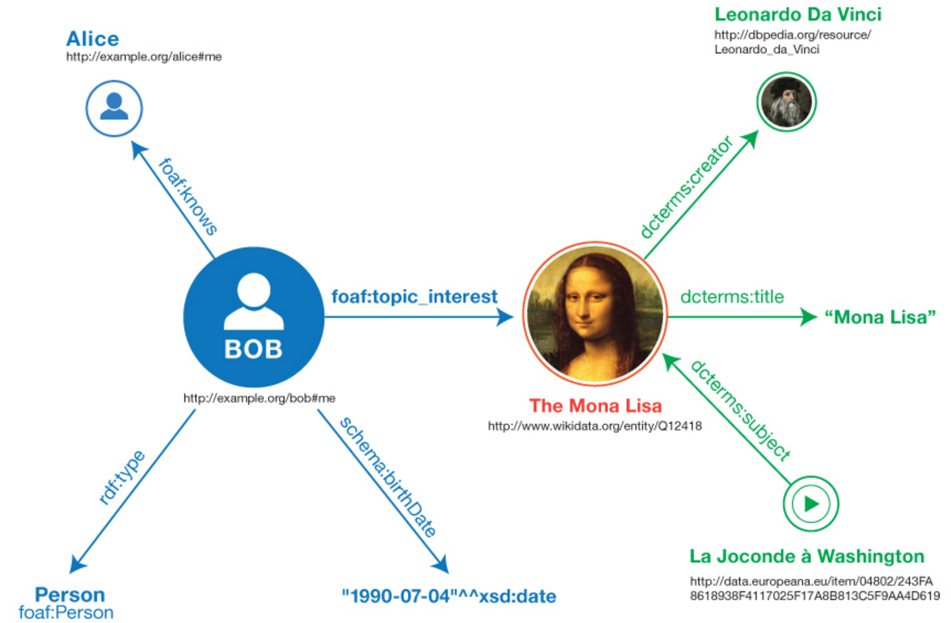
RDF View on Property Graph Data
Use W3C RDB2RDF
Property graph modeled with relational tables/views in Oracle
Define an R2RML mapping
Open question: can we add a bit of RDF to a PG graph?
VID | K | T | V | VN
1 | name | 1 | BOB
2 | name | 1 | The Mona Lisa
… | … | … | … | …
18
Notes:
The property graph is what we have introduced on the Big Data platform. Again, it’s the most basic graph structure and is a very simple and flexible type of graph. It can pull together a lot of disparate information for analysis.
This is a more formal view of what the property graph data model looks like. In the property graph world, nodes are called vertices and links are called edges.
You have a set of vertices with properties (or attributes ) in the form of key value pairs and you have a set of edges connecting these vertices.
We support theTinkerpop technology stack – Blueprint graph manipulation APIs, Pipes data flow APIs, Gremlin graph traversal language– to which Oracle has added built-in analytics functions

Slide 19
Summary
Under active development
Semantic web/RDF/OWL/GeoSPARQL/RDB2RDF improvement
Property graph
Challenges
Efficient graph query across distributed system
Support multiple platforms
Relational Database, Big Data (Hadoop stack), and Cloud
Tight integration of graph data with other data types from various sources
More tools, UI, and better usability!
19
Notes:
The property graph is what we have introduced on the Big Data platform. Again, it’s the most basic graph structure and is a very simple and flexible type of graph. It can pull together a lot of disparate information for analysis.
This is a more formal view of what the property graph data model looks like. In the property graph world, nodes are called vertices and links are called edges.
You have a set of vertices with properties (or attributes ) in the form of key value pairs and you have a set of edges connecting these vertices.
We support theTinkerpop technology stack – Blueprint graph manipulation APIs, Pipes data flow APIs, Gremlin graph traversal language– to which Oracle has added built-in analytics functions

Slide 20
Property Graph vs RDF Graph
Property Graph
Simpler: no formal theoretical foundation, no semantics, no inference
Easy to associate properties with edges
Community driven. No standards yet
Processing multiple property graphs is hard
Has no standard terms, vocabularies
A property graph can be modeled as an RDF Graph
RDF Graph
Has formal theoretical foundation: interpretation, entailment, description logic
Hard to associate properties with edges
Numerous W3C and OGC standards
Very natural to handle multiple RDF graphs at the same time
Has many curated terms, ontologies
An RDF graph can be modeled as a property graph with a loss of semantics
20
Notes:
The property graph is what we have introduced on the Big Data platform. Again, it’s the most basic graph structure and is a very simple and flexible type of graph. It can pull together a lot of disparate information for analysis.
This is a more formal view of what the property graph data model looks like. In the property graph world, nodes are called vertices and links are called edges.
You have a set of vertices with properties (or attributes ) in the form of key value pairs and you have a set of edges connecting these vertices.
We support theTinkerpop technology stack – Blueprint graph manipulation APIs, Pipes data flow APIs, Gremlin graph traversal language– to which Oracle has added built-in analytics functions

